Slide 1


Business Order
Just a regular order shipment on some products the museum

Slide 2
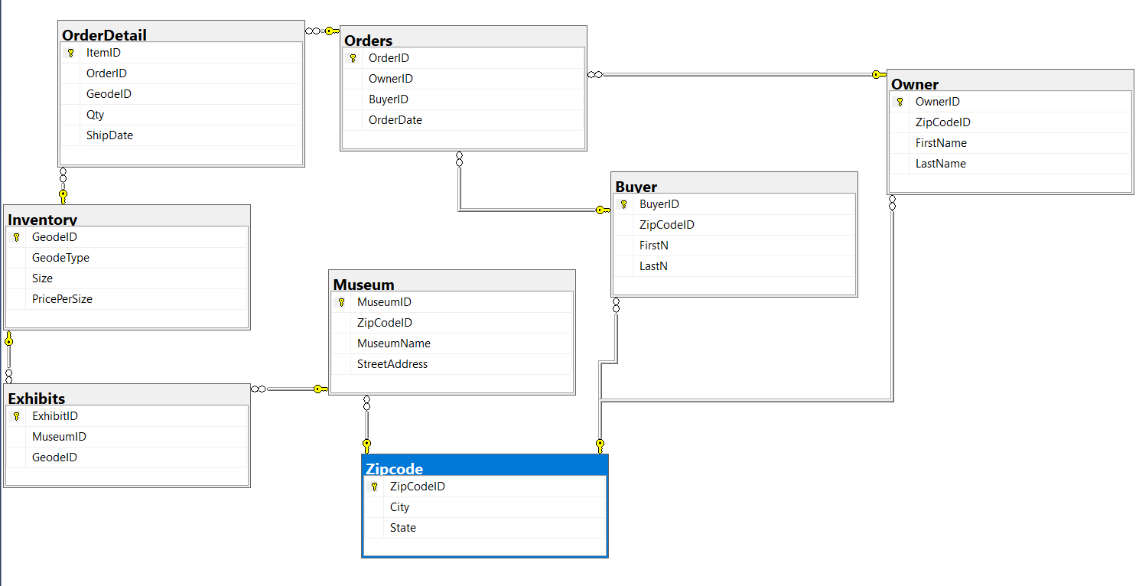
Database Diagram

Slide 3
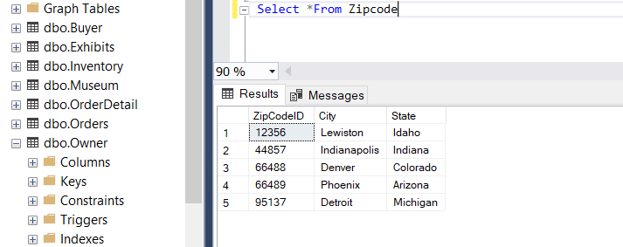
Zipcode (aka location)

Slide 4
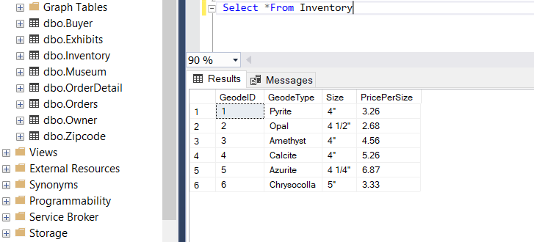
Inventory (what’s in stock)

Slide 5
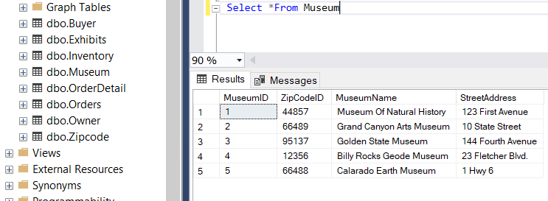
Museums

Slide 6
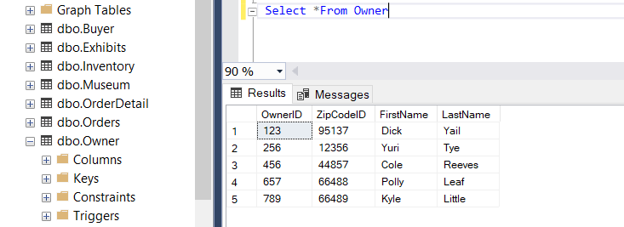
Museum Owners

Slide 7
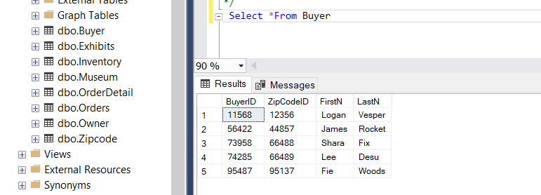
Buyers (those who make the orders)

Slide 8
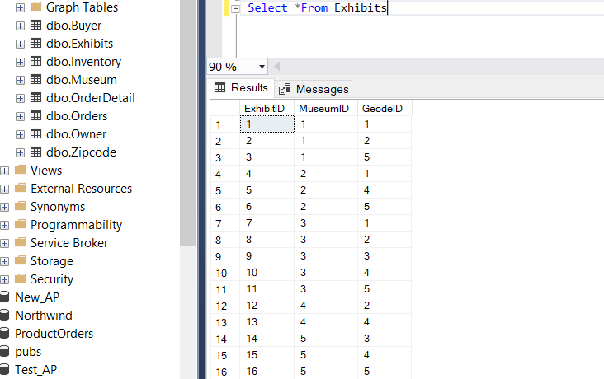
Exhibits

Slide 9
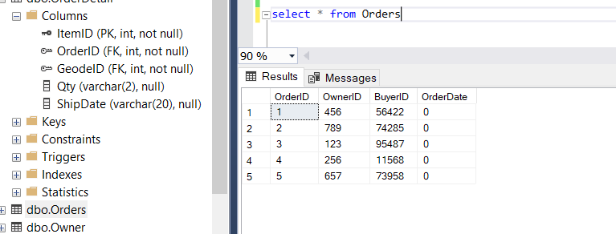
Orders (made)

Slide 10
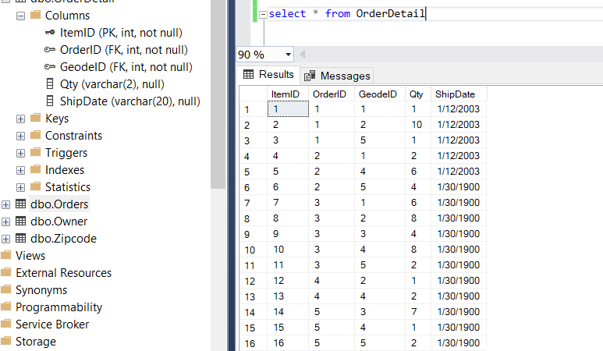
Overall OrderDetail

Slide 11

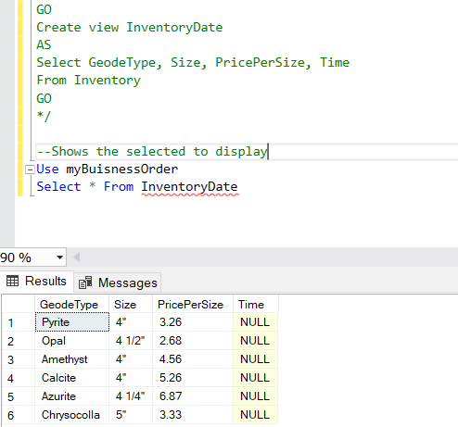
Summary #1

Slide 12
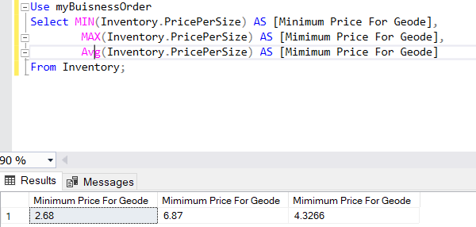
Summary #2

Slide 13
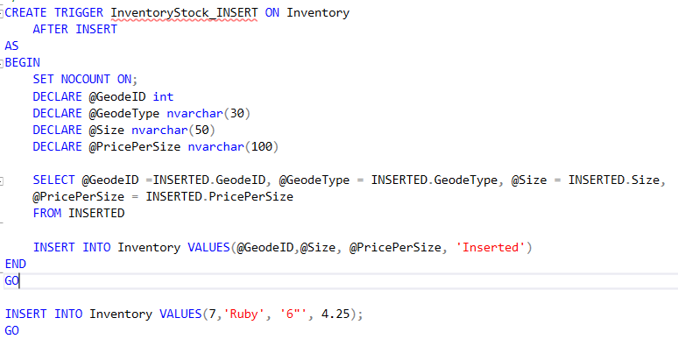
Trigger #1

Slide 14
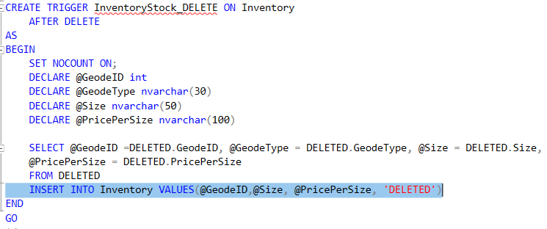
Trigger #2

Slide 15
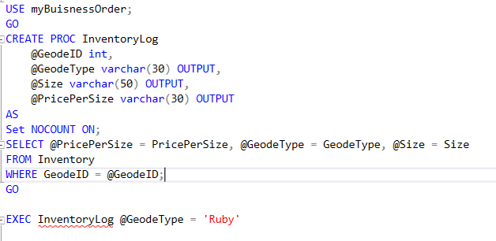
Stored Procedure #1

Slide 16
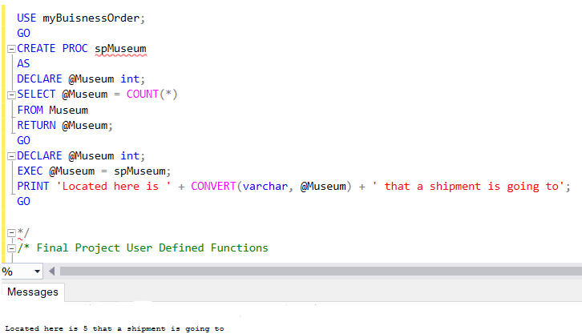
Stored Procedure #2

Slide 17
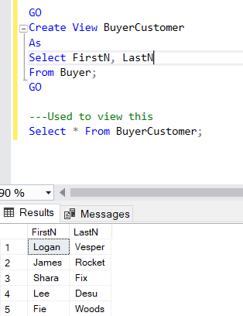
View #1

Slide 18
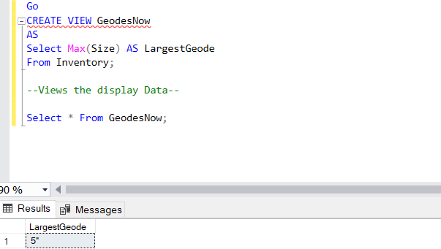
View #2

Slide 19
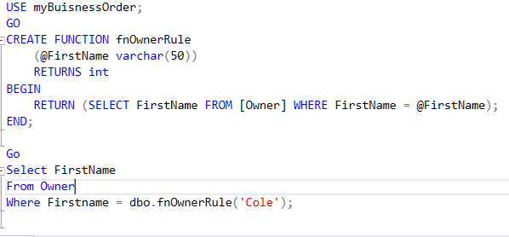
Defined Function #1

Slide 20
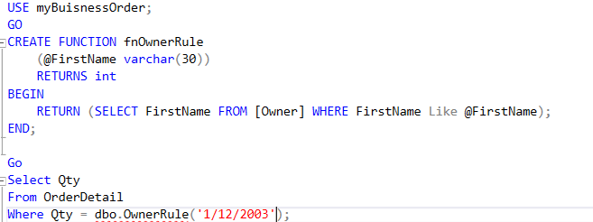
Defined Function #2

Slide 21
Things That Went Well
To be frank, most of this went very well. As far as being able to insert data and even being allowed to do things the way I want.

Slide 22
The Problems I Had
I feel the main issue I had while doing this project was being able to properly connect different tables with other ones from another primary source.

Slide 23
What I Learned
I feel the primary thing I learned while doing this is that everything, and data can be connected to each other as long as a few requirements are met.

Slide 24
What I would Like To Include
I would have like to incorporated some relations between geode types and the buyers that had purchased them.

